Slide 1
Progress update
Joe and Sohail
April 11, 2017

Slide 2
Statement of problem
Can we predict which ablation procedures will lead to de novo RD sites and recurrent AF?
What can we glean from a cardiac model that will allow us to make that prediction?
Classification problem: (AF->AF) vs. (AF->AT)

Slide 3
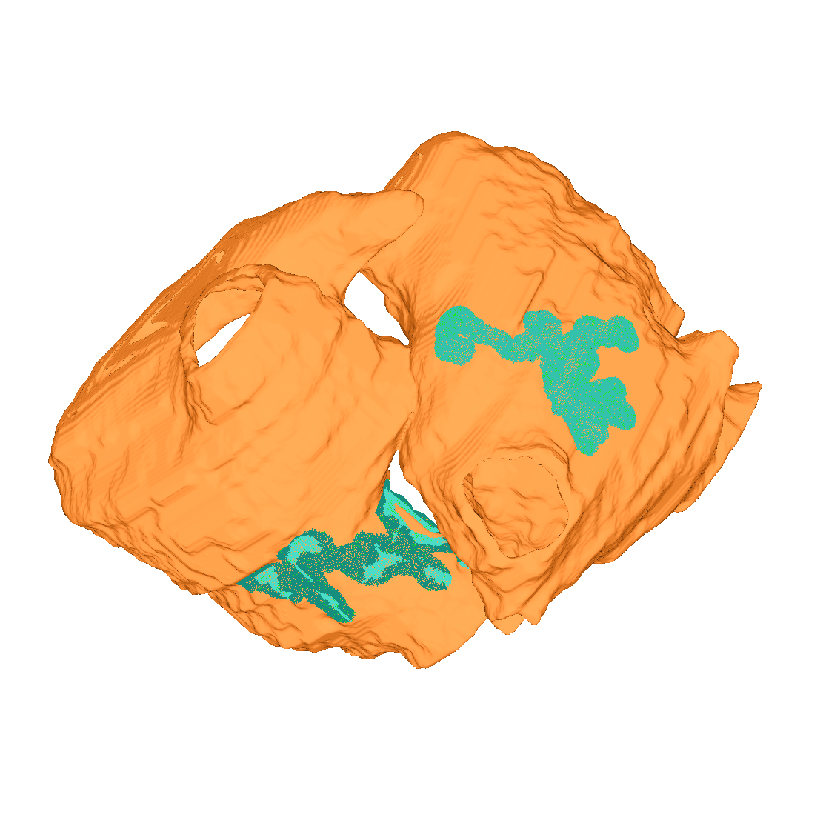
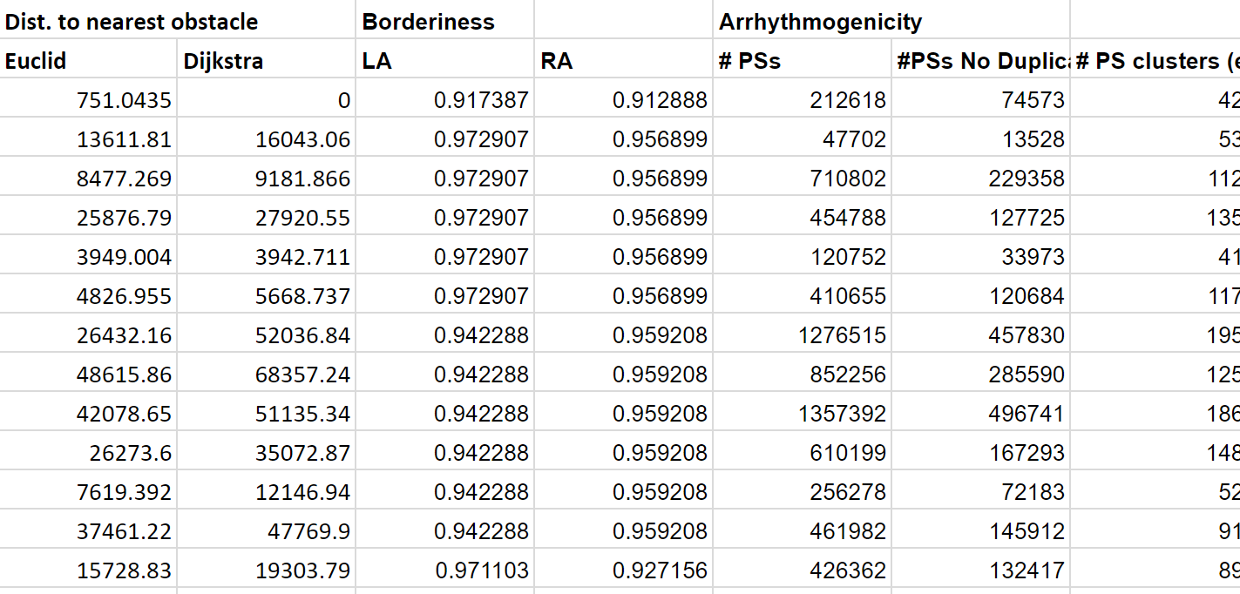
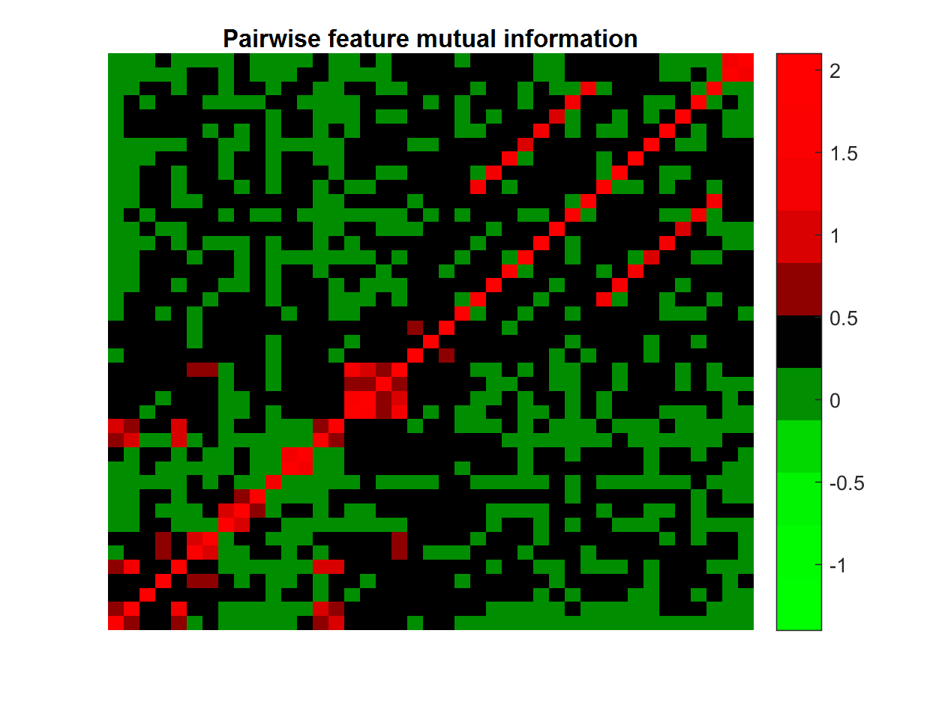
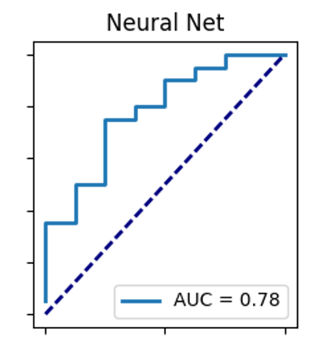
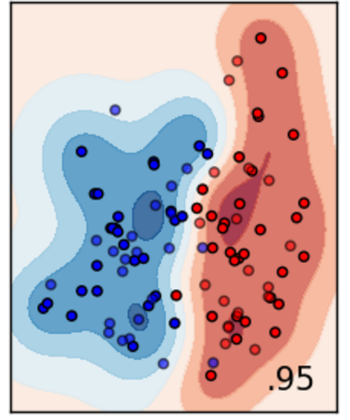
Extracting features from the dataset: workflow
Extract features
Importance weighting
Apply classifiers
Measure classifying success

Slide 4
Most discriminative features
Evaluated by χ², F-statistic, mutual information, and regression
Top three performing features:
Fibrotic burden
Lesion size
Proximity of lesion to nearest obstacle (by Dijkstra’s algorithm)

Slide 5
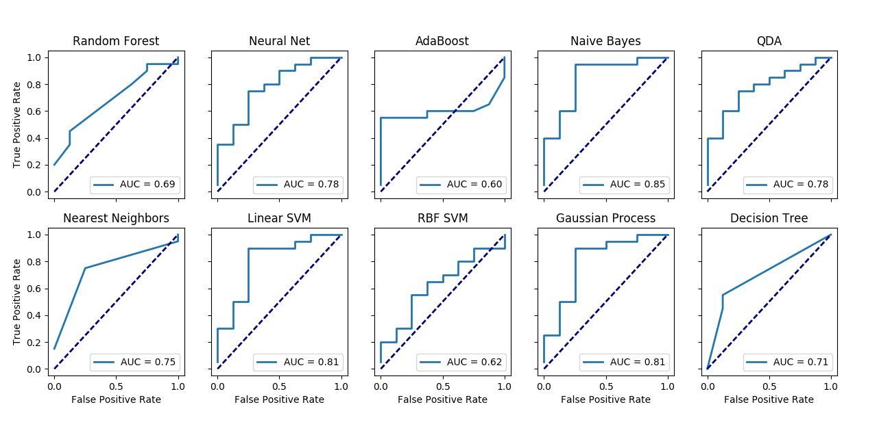
Classification is effective by multiple approaches

Slide 6
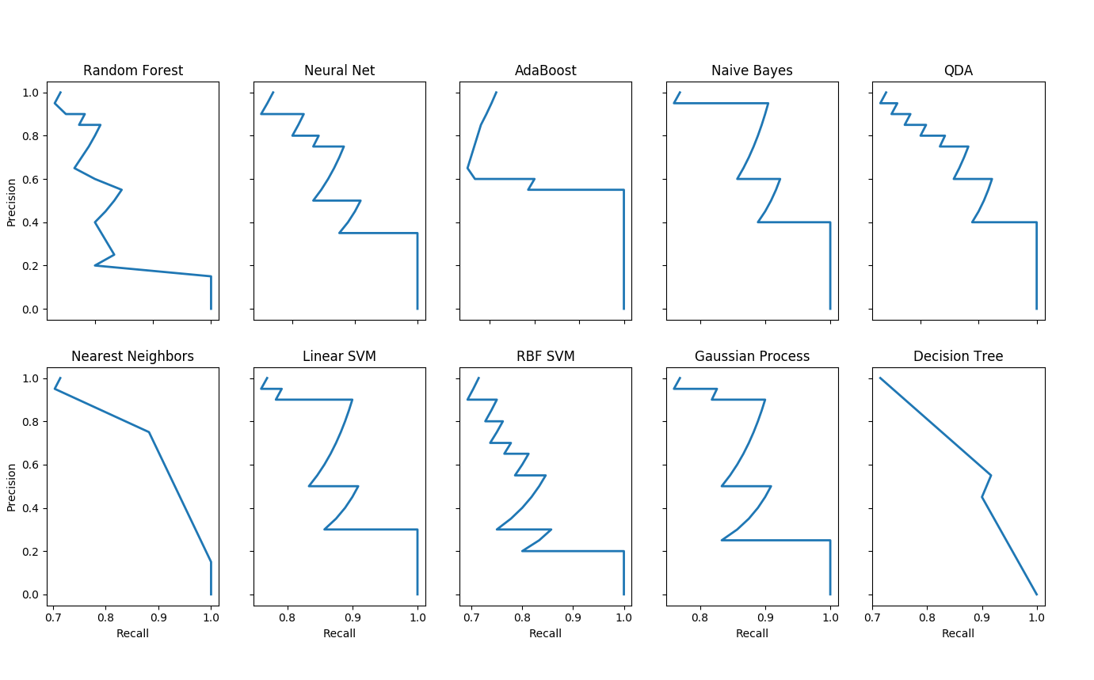
Precision recall curves

Slide 7
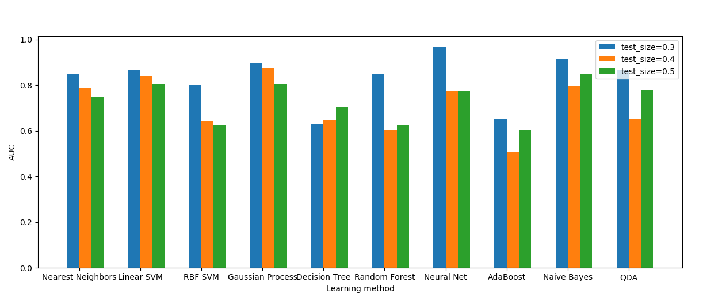
Classification is robust to approaches and test set portion

Slide 8
Example recurrent heart
Should I include something here?

Slide 9
Example non recurrent heart

Slide 10
Conclusions
We can extract fundamentally informative features from:
Individual fibrotic architecture
Ablation lesion characteristics
These features allow discrimination of patients into recurrent and nonrecurrent subsets without the need for simulation
The features are simple and can be easily estimated, making them more accessible and implementable

Slide 11
Future directions
Check if these features are indicative of recurrence in the clinic
Run simulations modulating…
Ablation size, perimeter/area
Closeness to nonconducting obstacle
…and view reinducibility in each case:
Do less circular lesions allow anchoring?
Is it the connection to nonconducting obstacles, or the proximity?

